Slide 1
User Personas
Product Management Bootcamp, M4
<Zara Rahman>

Slide 2
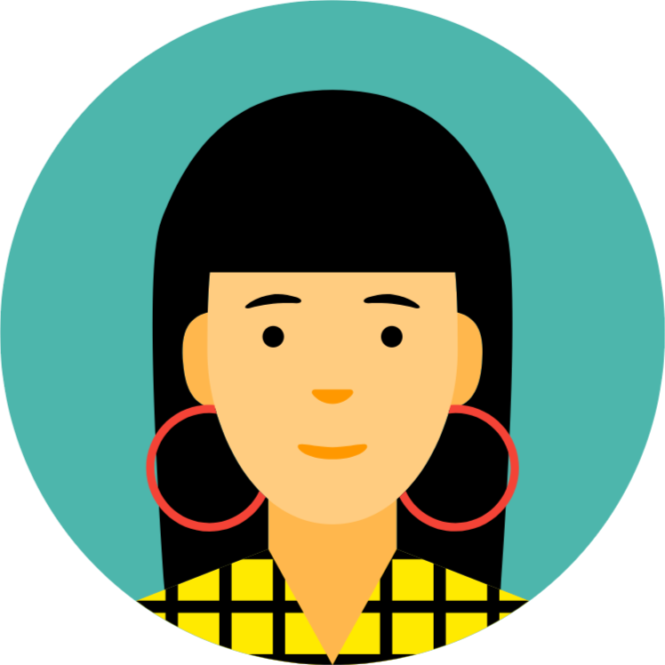
Marriam
Additional Background (occupation, education level, roles outside of work) | Has balloon decor business with her husband called “The Balloon Factory” Makes $48,000 a year in salary Bachelor’s Degree Likes to travel during off time DINK - dual income no kids Researches travel deals for fun Family oriented
Experience Level/Skills | Entrepreneurial Creative Organized Building relationships and networking Somewhat technologically savvy
Goals | Wants to prove you don’t need a high salary to have meaningful and memorable travel experiences Travel the world on a budget before having children with her husband Wants her small business to take off
Tagline | I could be working a normal, stable job, but I value challenging myself. I want to be in control of my life and my experiences.
Quotes | “I do all the research on traveling by myself, and organize everything. I create my own itineraries, and even love doing it for other people.” “I am so stressed out all the time with running my small business, my breaks aren’t really structured. I really want the breaks I do take to be enriching and exciting.”
Product Interaction (frequency of use, preferred device, etc.) | Frequency of use: high Preferred device: laptop Brand loyalty: high
32
she/her

